Slide 1

22년 삼성 AI 전문가과정
6월 7일 화요일 1교시
장병탁
인공지능
1차시 : Introduction
서울대학교 컴퓨터공학부
담당 교수: 장병탁
Seoul National University
Byoung-Tak Zhang

Slide 2
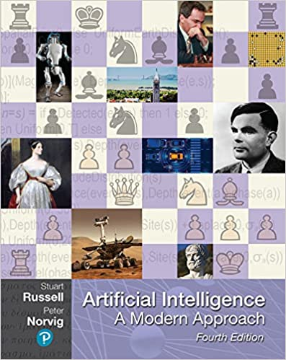
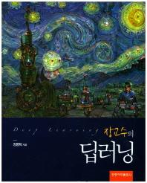
Course Overview (1/3)
4190.408 Artificial Intelligence, Spring 2022 (SNU Hybrid Course)
Textbooks
(Primary) Russell & Norvig, Artificial Intelligence: A Modern Approach, 4th Edition, Pearson, 2021.
(Secondary) 장교수의 딥러닝 (홍릉과학출판사), 2017
Class hours: Tue/Thu 2:00-3:15pm
SNU hybrid course (3 modes)
Hybrid (15): Offline (Bldg 43-1, Room 306) + Online (Zoom)
Video (6): Pre-recorded video lectures
Online (4): Zoom, TA tutorial sessions
Teaching assistants
Chang-Hoon Jeong (Head TA), Yeon-Ji Song, Yun-Hyeok Kwak,
You-Won Jang, Jun-Seok Park, Jung-Hyun Kim
Contact: chjeong@bi.snu.ac.kr

Slide 3
Course Overview (2/3)
Teaching Assistants
(Head TA)
PhD Student
Dept. of Computer Science and Engineering
MS Student
Interdisciplinary Program in Neuroscience
MS Student
Interdisciplinary Program in Neuroscience
PhD Student
Interdisciplinary Program in Neuroscience
PhD Student
Dept. of Computer Science and Engineering
MS Student
Interdisciplinary Program in Artificial Intelligence

Slide 4
Course Overview (3/3)
Ten homework assignments
Exercises in the course textbooks https://aimacode.github.io/aima-exercises/
Two exams
Midterm exam and Final exam
Two projects
Project 1: Disease diagnosis using Bayesian networks
Project 2: Your own AI projects with deep learning
Four TA tutorial sessions (Weeks 7 & 11)
Scientific computing with Python (Week 7, Tue)
Bayesian Networks (Week 7, Thu)
Deep neural networks (Week 11, Tue)
Advanced deep learning (Week 11, Thu)
Grading Policy
Attendance/Participation (10%)
Assignments (20%)
Projects (20%)
Midterm Exam (25%)
Final Exam (25%)
Check out more details on the course!
Course: https://bit.ly/snu-ai-2022-spring-course
Syllabus: https://bit.ly/snu-ai-2022-spring-syllabus

Slide 5
Lecture Overview
인공지능
1차시 : Introduction
서울대학교 컴퓨터공학부
담당 교수: 장병탁
Seoul National University
Byoung-Tak Zhang

Slide 6
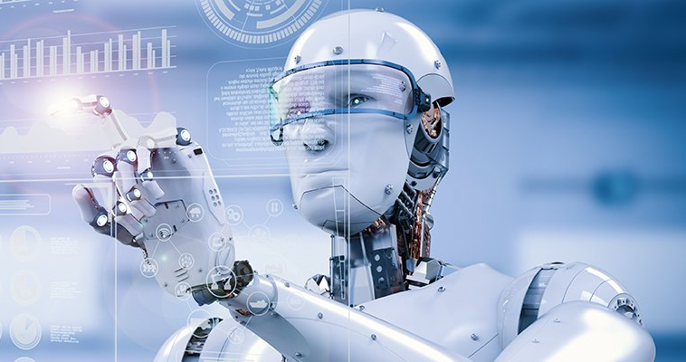
Lecture 1. Introduction
출처: Figure #7
What is the Artificial Intelligence (AI)?
Thinking Humanly
Thinking Rationally
Acting Humanly
Acting Rationally
The Foundations of AI
Philosophy, Mathematics, Psychology, Economics, Linguistics, Neuroscience, Control theory
History of Artificial Intelligence (AI)
AI’s Winter & Deep Learning
State of the Art
What can AI do today? What are the applications of AI?
“A computer would deserve to be called intelligent if it could deceive a human into believing that it was human.”
Alan Mathison Turing (1912-1954)

Slide 7
What Is AI?
Approaches to AI
Thinking Humanly The new effort to make computers think . . . machines with minds. Automation of activities … human thinking, such as decision making and problem solving. | Thinking Rationally The study of mental faculties through the use of computational models. The study of the computation that make it possible to perceive, reason, and act.
Acting Humanly The art of creating machines that perform functions that require intelligence when performed by people. The study of how to make computers do things at which, at the moment, people are better. | Acting Rationally Artificial intelligence is the study of the design of intelligent agents. AI is concerned with intelligent behavior in artifacts.

Slide 8
Lecture 1. Introduction
1943-1956: The birth of artificial intelligence
1956-1969: Early enthusiasm, great expectation
1970-1985: Expert systems become industry
DENDRAL, MYCIN, X-Con
1986-: Return of neural networks (learning systems)
1987-2005: AI’s Winter & AI adoptsv scientific methods
Machine learning (& neural networks)
Probabilistic inference (& Bayesian networks)
Intelligent agents (& mobile robots)
2000s: Very large data sets (Web, SNS, mobile)
Machine learning applications
2012-present: Deep learning becomes industry

Slide 9
Lecture 1. Introduction
출처: Figure #7
What is the Artificial Intelligence (AI)?
Thinking Humanly
Thinking Rationally
Acting Humanly
Acting Rationally
The Foundations of AI
Philosophy, Mathematics, Psychology, Economics, Linguistics, Neuroscience, Control theory
History of Artificial Intelligence (AI)
AI’s Winter & Deep Learning
State of the Art
What can AI do today? What are the applications of AI?
“A computer would deserve to be called intelligent if it could deceive a human into believing that it was human.”
Alan Mathison Turing (1912-1954)

Slide 10
Outline (Lecture 1)
1.1 What Is AI?
1.2 Foundations of AI
1.3 History of AI
1.4 State of the Art
Summary
10
17
19
24
27

Slide 11
1.1. What Is AI?

Slide 12
1.1 What Is AI? (1/6)
Approaches to AI
Thinking Humanly The new effort to make computers think . . . machines with minds. Automation of activities … human thinking, such as decision making and problem solving. | Thinking Rationally The study of mental faculties through the use of computational models. The study of the computation that make it possible to perceive, reason, and act.
Acting Humanly The art of creating machines that perform functions that require intelligence when performed by people. The study of how to make computers do things at which, at the moment, people are better. | Acting Rationally Artificial intelligence is the study of the design of intelligent agents. AI is concerned with intelligent behavior in artifacts.

Slide 13
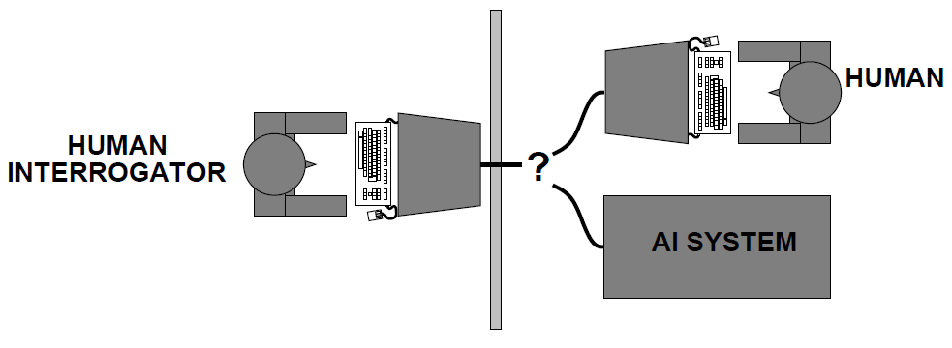
1.1 What Is AI? (2/6)
1) Acting humanly: The Turing test approach
Build a machine that behaves intelligently like humans
Turing test or imitation game (1950): operational definition of intelligence
A computer passes the test if a human interrogator, after posing some written questions, cannot tell whether the written responses come from a person or a computer
Predicted that by the year 2000, a machine might have a 30% chance of fooling a lay person for 5 minutes
Key capabilities
Natural language processing
Knowledge representation
Automated reasoning
Machine learning
“Can machines think?”→ “Can machines behave intelligently?”
Turing’s test deliberately avoided direct physical interaction between the interrogator and the computer
Total Turing Test requires additionally: computer vision and robotics
출처: Figure #1

Slide 14
1.1 What Is AI? (3/6)
2) Thinking humanly: The cognitive modeling approach
Build a human-level general intelligence like human minds
How to know the actual workings of human minds: cognitive science
Once we have a sufficiently precise theory of the human mind, it becomes possible to express the theory as a computer program
General problem solver (GPS) (Newell & Simon, 1961)
AI as science: If the program’s input-output behavior matches human behavior, that is evidence that some of the program’s mechanisms could also be operating in human.
Cognitive science brings together computer models from AI and experimental techniques from psychology to construct precise and testable theories of the human mind.

Slide 15
1.1 What Is AI? (4/6)
3) Thinking rationally: The laws of thought approach
Build a machine that thinks right (or reasons rationally)
Normative (or prescriptive) rather than descriptive
Aristotle: what are correct arguments/thought processes?
Syllogism: deriving correct conclusions from correct premises
Logic: notation and rules of derivation for thoughts
Logicist tradition in AI: “good-old-fashioned AI” (GOFAI)
Obstacles:
Not easy to convert informal knowledge to formal terms in logic
Logical reasoning systems can exhaust computational resources
Not all intelligent behavior is mediated by logical deliberation

Slide 16
1.1 What Is AI? (5/6)
4) Acting rationally: The rational agent approach
Build a machine that behaves rationally or does the right thing
A rational agent is one that acts so as to achieve the best expected outcome
The right thing: that which is expected to maximize goal achievement, given the available information
Doesn't necessarily involve thinking (e.g., blinking reflex) but
thinking should be in the service of rational action
To act rationally requires to reason logically to the conclusion
Advantages:
More general than the “laws of thought” approach: beyond correct inference
Rationality is mathematically well defined and completely general

Slide 17

1.1 What Is AI? (6/6)
Rational Agents
An agent is an entity that perceives and acts
This course is about designing rational agents
Abstractly, an agent is a function from percept histories to actions:
For any given class of environments and tasks,
we seek the agent (or class of agents) with the best performance
Caveat:
Computational limitations make perfect rationality unachievable
Design best program for given machine resources

Slide 18
1.2. The Foundation of AI

Slide 19
1.2 The Foundations of AI
AI prehistory
Philosophy : logic, methods of reasoning
Mathematics : formal representation and proof, algorithms, computation
Psychology : human mind, thinking, acting
Economics : formal theory of rational decisions
Linguistics : knowledge representation, grammar
Neuroscience : plastic physical substrate for mental activity
Control theory : homeostatic systems, stability

Slide 20
1.3. The History of AI

Slide 21
1.3 History of AI (1/4)
1943-1956: The birth of artificial intelligence
1956-1969: Early enthusiasm, great expectation
1970-1985: Expert systems become industry
DENDRAL, MYCIN, X-Con
1986-: Return of neural networks (learning systems)
1987-2005: AI’s Winter & AI adopts scientific methods
Machine learning (& neural networks)
Probabilistic inference (& Bayesian networks)
Intelligent agents (& mobile robots)
2000s: Very large data sets (Web, SNS, mobile)
Machine learning applications
2012-present: Deep learning becomes industry

Slide 22
1.3 History of AI (2/4)
1943 McCulloch & Pitts: Boolean circuit model of brain
1950 Turing's “Computing Machinery and Intelligence"
1952~69 Early enthusiasm, great expectation
1950s Early AI programs, including Samuel's checkers program,
Newell & Simon's Logic Theorist, Gelernter's Geometry Engine
1956 Dartmouth meeting: “Artificial Intelligence” adopted
1965 Robinson's complete algorithm for logical reasoning
1966~74 AI discovers computational complexity
Neural network research almost disappears

Slide 23
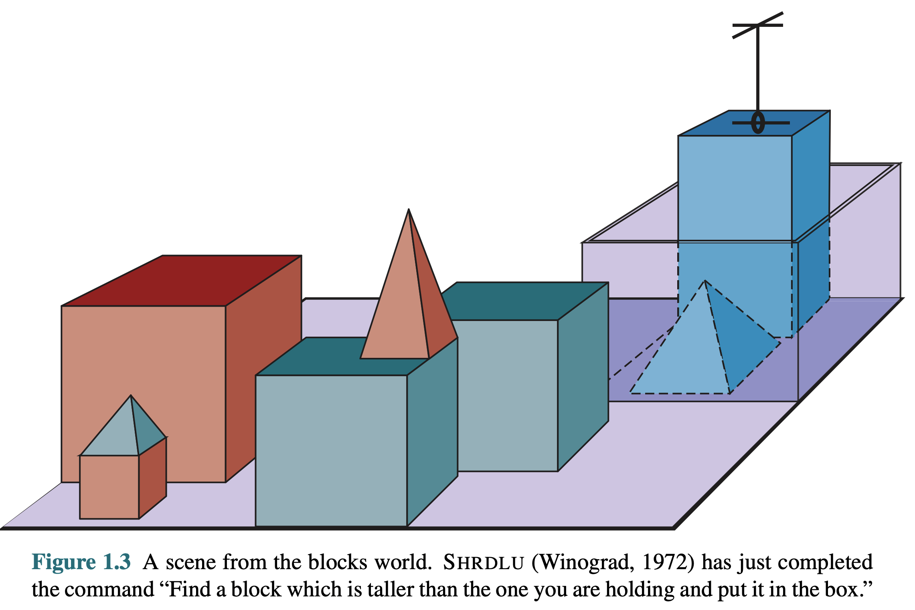
1.3 History of AI (3/4)
출처: Figure #1

Slide 24
1.3 History of AI (4/4)
1969~79 Early development of knowledge-based systems
1980~88 Expert systems industry booms
1988~93 Expert systems industry busts: “AI Winter"
1985~95 Neural networks return to popularity
1988~ Resurgence of probability; general increase in technical depth
“Nouvelle AI”: ALife, GAs, soft computing
1995~ Agents, agents, everywhere…
2005~ Human-level AI back on the agenda
2010~ Self-driving cars, Watson, Siri, Alexa, …
2012~ Deep learning becomes industry
2016~ AlphaGo, GPT-3, DALL‧E

Slide 25
1.4. State of the Art

Slide 26
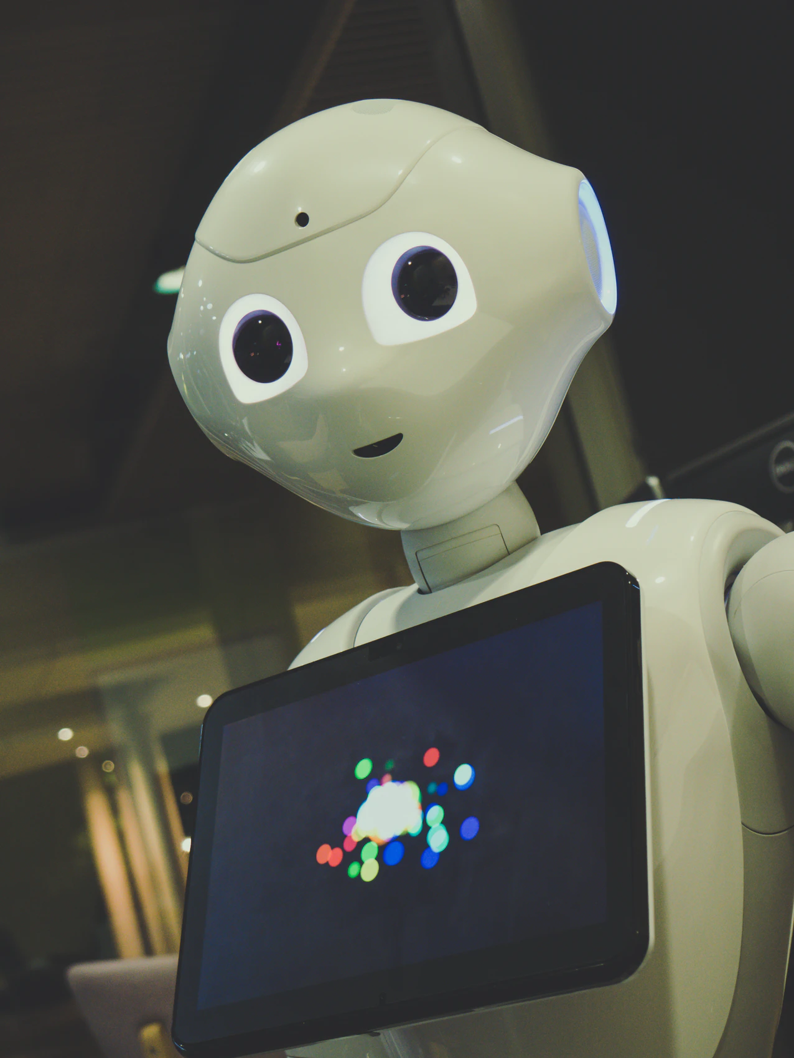
1.4 State of the Art (1/2)
What can AI do today?
Self-driving cars: Stanley (Stanford)
Speech recognition: Duplex (Google)
Face recognition: DeepFace (Facebook)
Image generation: GAN (NVIDIA)
Personal assistant: Siri (Apple), Alexa (Amazon)
Planning and scheduling: Sojourner (NASA)
Game playing: AlphaGo (DeepMind)
Autonomous robots: Rosie (TUM), Atlas (Boston Dynamics)
Machine translation: NeuralMT (Google)

Slide 27
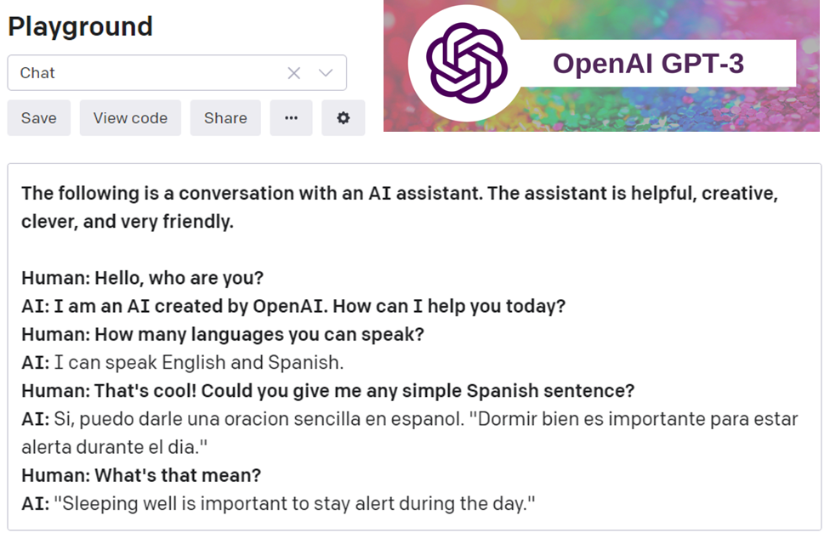
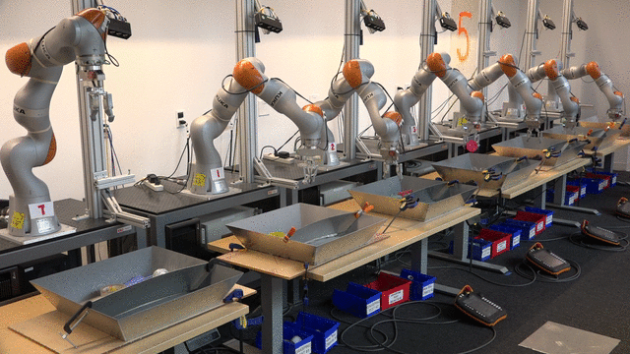
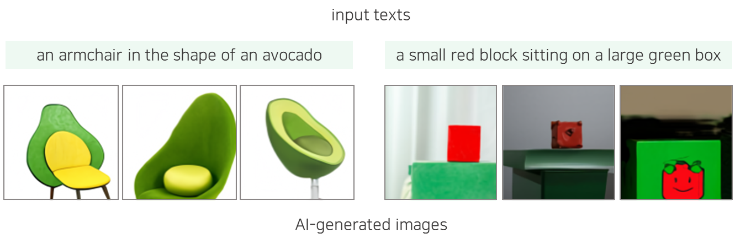
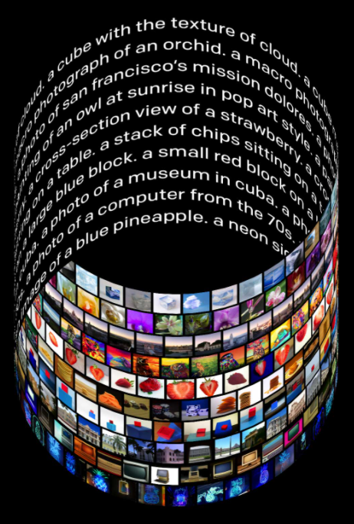
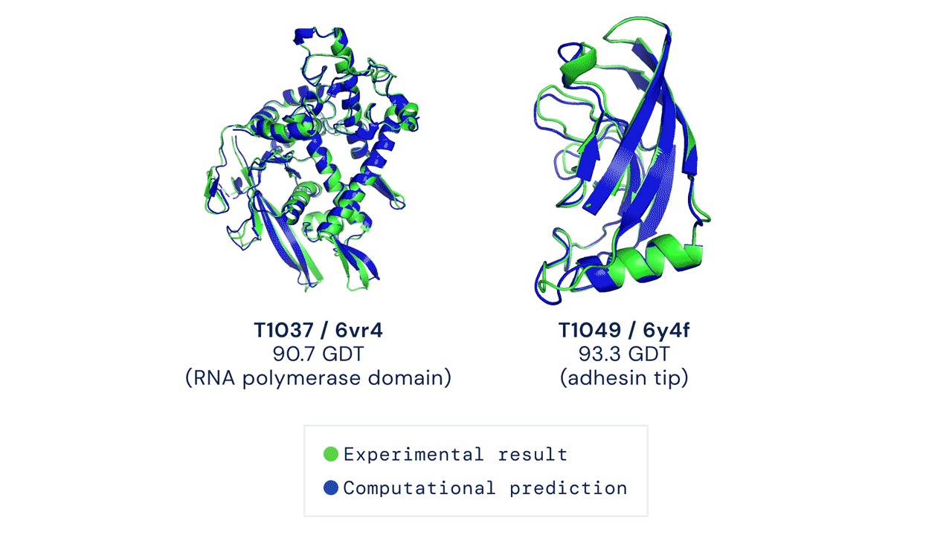
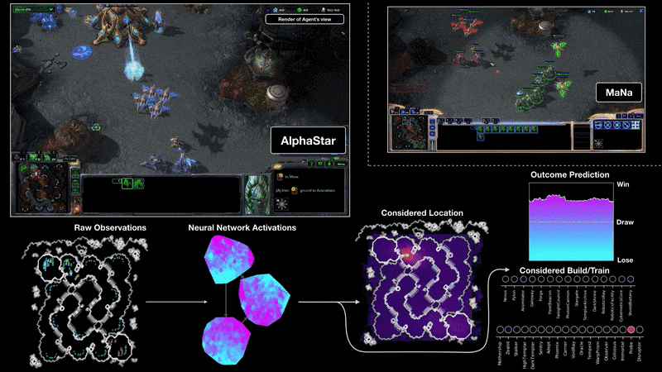
1.4 State of the Art (2/2)
OpenAI GPT-3 (Brown et al. 2020)
QT-Opt (Kalashnikov et al. 2018)
DALL‧E (Ramesh et al. 2021)
출처: Figure #2
출처: Figure #4
AlphaStar (Vinyal et al. 2019)
AlphaFold (Perez et al. 2022)
출처: Figure #6
출처: Figure #3
출처: Figure #5

Slide 28
Summary
Intelligence is concerned mainly with rational action.
Ideally, an intelligent agent takes the best possible action in a situation.
AI is an interdisciplinary effort that has been influenced by and has influenced other disciplines, such as philosophy, mathematics, psychology, and neuroscience.
The history of AI has had cycles of success, misplaced optimism, and resulting cutbacks in enthusiasm and funding.
AI has advanced more rapidly in the past decade because of greater use of the scientific method in experimenting with and comparing approaches.
Deep learning has revolutionized AI by enabling intelligent systems to be developed automatically by data-driven learning rather than knowledge-based programming when big data are available.

Slide 29

References
Figures
#1 Stuart J. Russell and Peter Norvig. Artificial Intelligence: A Modern Approach (4rd Edition). Pearson
#2 GPT-3 Powers the Next Generation of Apps. OpenAI. https://openai.com/blog/gpt-3-apps/
#3 Alphastar: Mastering the real-time strategy game starcraft II. DeepMind. https://deepmind.com/blog/article/alphastar-mastering-real-time-strategy-game-starcraft-ii
#4 Scalable Deep Reinforcement Learning for Robotic Manipulation. Google Research. https://ai.googleblog.com/2018/06/scalable-deep-reinforcement-learning.html
#5 AlphaFold: A solution to a 50-year-old grand challenge biology. DeepMind. https://deepmind.com/blog/article/alphafold-a-solution-to-a-50-year-old-grand-challenge-in-biology
#6 DALL-E Creating Images from Text. OpenAI. https://openai.com/blog/dall-e/
#7 http://www.icorp.com.mx/blog/automatizacion-robotica-de-procesos/

